Slide 1











SMAR TDRIVE IOV: ENSURING SAFETY AND INTELLIGENCE IN PUBLIC TRANSPORTATION.
GROUP 2
113598025 林鈺翔
113598064 陳貫唯
113598096 陳新義
113598043 張育丞

Slide 2
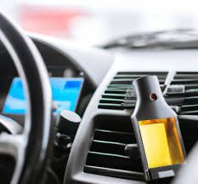
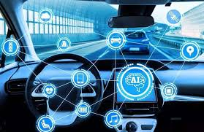
PROJECT DESCRIPTION
This project implements an anti-drunk driving system using alcohol detection technology, combined with ultrasonic radar for environmental sensing around vehicles, and provides anomaly warnings through a buzzer. Additionally, we integrate YOLO, OpenPose, and Artificial Neural Networks (ANN) to achieve precise detection and behavior prediction for passengers and vehicles. A voice system is also incorporated to provide real-time alerts to public transportation drivers.
The process fully demonstrates multi-layered monitoring capabilities in artificial intelligence, data analysis, and anomaly warning, enhancing the embedded system-based Internet of Vehicles (IoV) architecture. Furthermore, we have developed optional features such as vehicle arrival detection via Wi-Fi and Bluetooth, lane-centering alerts, and turn signal control, aiming to improve the safety and intelligent management of public transportation.

Slide 3
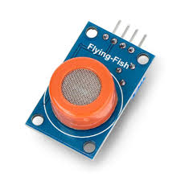
ALCOHOL SENSOR MQ-3
The MQ-3 is a highly sensitive gas sensor designed to detect alcohol concentration in the air.
The output signal can be applied to electronic circuits for quantitative analysis of alcohol content.

Slide 4
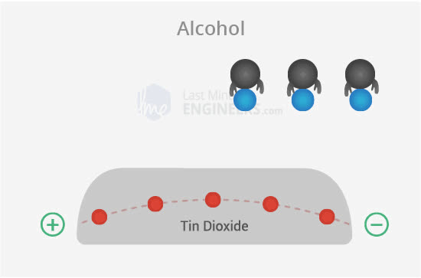
WORKING PRINCIPLE
Oxygen Adsorption: When the SnO2 semiconductor layer is heated to a high temperature, oxygen molecules are adsorbed on the surface, creating an electron depletion layer that increases the sensor impedance.
Alcohol Interference: When alcohol is present, the oxygen adsorbed on the surface decreases, lowering the potential barrier and releasing more electrons into the SnO2, allowing current to pass through.

Slide 5
ADVANTAGES AND DISADVANTAGES
Advantages
Quickly assesses whether a driver has consumed alcohol, serving as a critical component in alcohol lock systems or other safety mechanisms.
Low cost, wide detection range, and fast response time.
Disadvantages
A built-in heater is required to maintain the optimal operating temperature, necessitating a warm-up time of about 20 seconds.
May experience cross-interference in the presence of high concentrations of other gases.

Slide 6
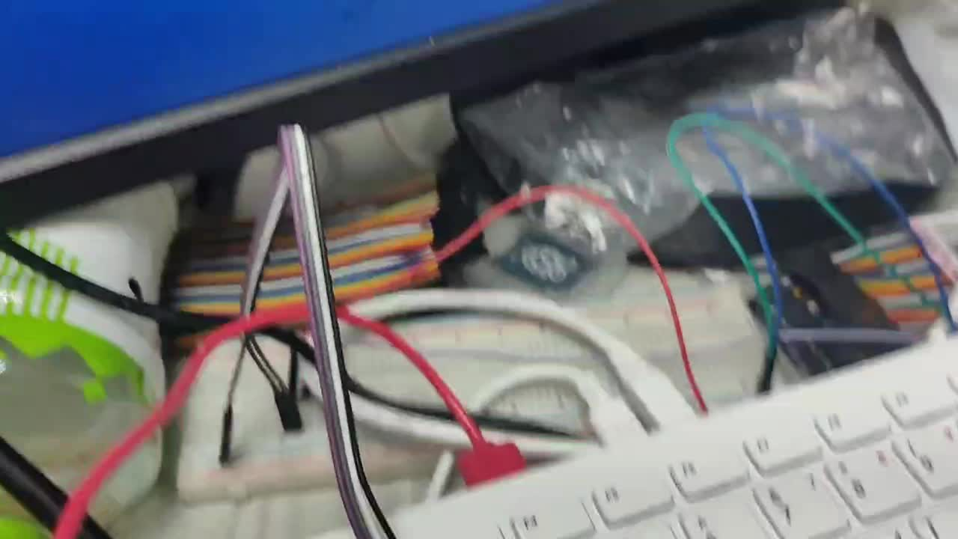
RESULTS

Slide 7
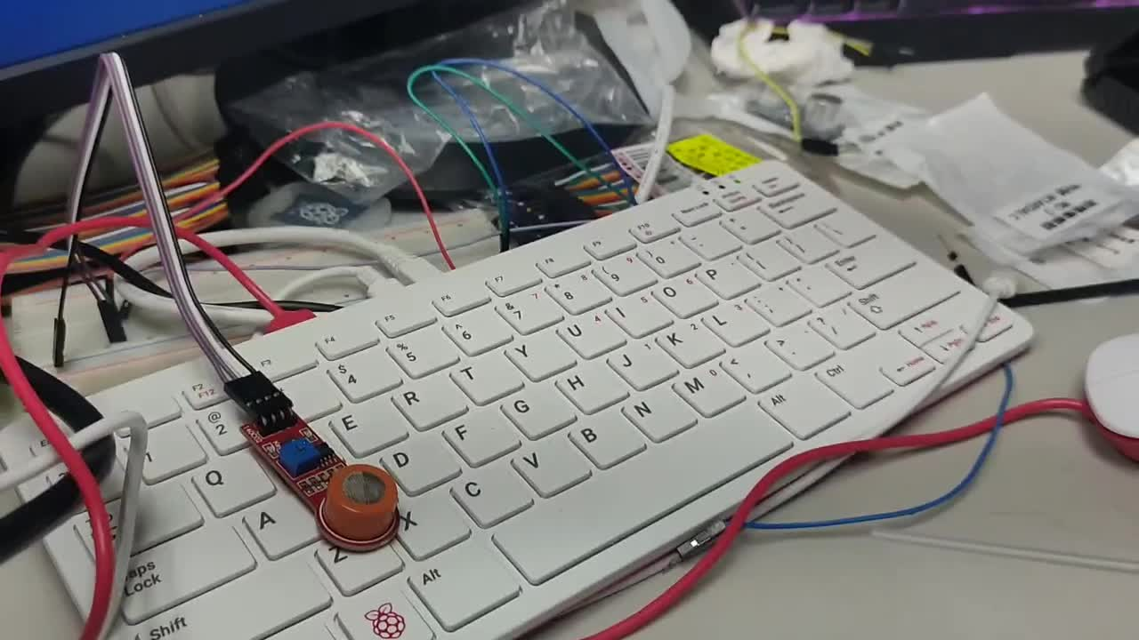
RESULTS

Slide 8
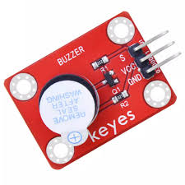
BUZZER
A buzzer is an electronic component that converts an electrical signal into an acoustic signal and is widely used in electronic devices to provide an audible alert or warning signal.

Slide 9
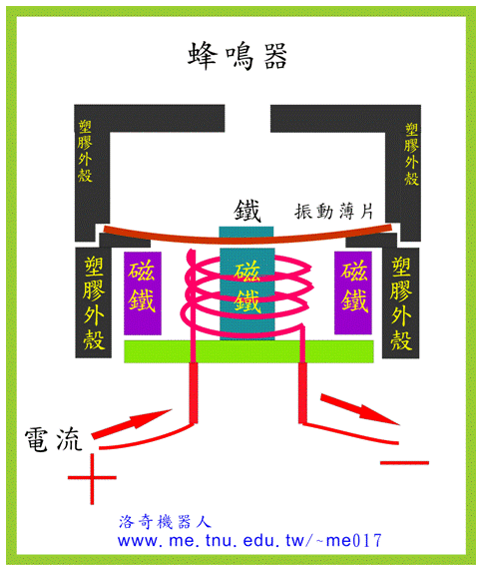
WORKING PRINCIPLE
Piezo buzzer
When the piezoelectric sheet is driven by an alternating voltage, mechanical vibration will be generated, and the vibration will drive the diaphragm to produce sound.
Electromagnetic buzzer
When energized, an electromagnetic coil generates a magnetic field that drives a metal diaphragm to produce sound.

Slide 10
ADVANTAGES AND DISADVANTAGES
Matching Voltage:
The buzzer should be used with a voltage that matches its specifications to avoid damage.
Sound Frequency
When choosing a passive buzzer, you need to consider the appropriate frequency driver circuit.
Environmental adaptability
The temperature and humidity of the environment may affect the performance of the buzzer.

Slide 11
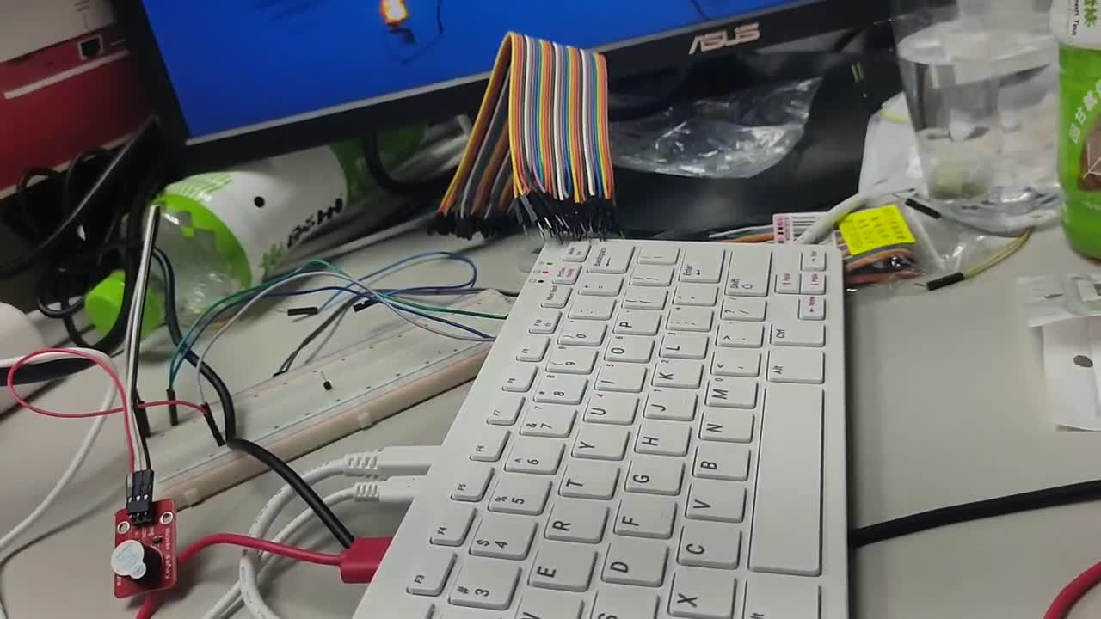
RESULTS

Slide 12
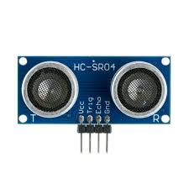
HC-SR04
ULTRASONIC SENSORS
The HC-SR04 is an ultrasonic distance measurement module that measures the distance of an object by emitting ultrasonic waves and receiving reflected waves, making it ideal for distance measurement applications.

Slide 13
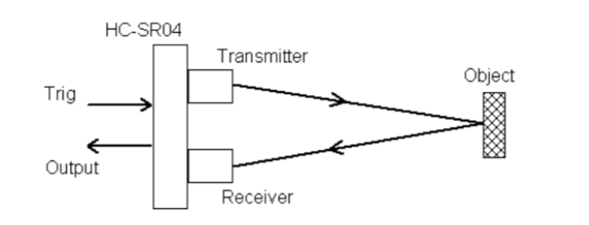
WORKING PRINCIPLE
Sensing Elements
Transmitter (T)：Labeled “T,” emits 40 kHz ultrasonic waves.
Receiver (R)：Labeled “R,” can detect ultrasonic waves within a range of 2 cm to 400 cm, at an approximate sensing angle of 15°.
Operating Principle
Apply a high-level signal of at least 10 microseconds to the Trig pin to trigger the transmitter, which then emits eight consecutive 40 kHz ultrasonic pulses.
When the receiver detects the echo, the module outputs a high-level pulse on the Echo pin, whose duration is proportional to the measured distance.

Slide 14
ADVANTAGES AND DISADVANTAGES
Advantages
Reversing radar and obstacle detection.
Measurements are fast and stable.
Disadvantages
Measurements are not suitable for sound-absorbing materials or for objects with specific shapes (e.g. soft objects).
Reversing radar and obstacle detection.

Slide 15
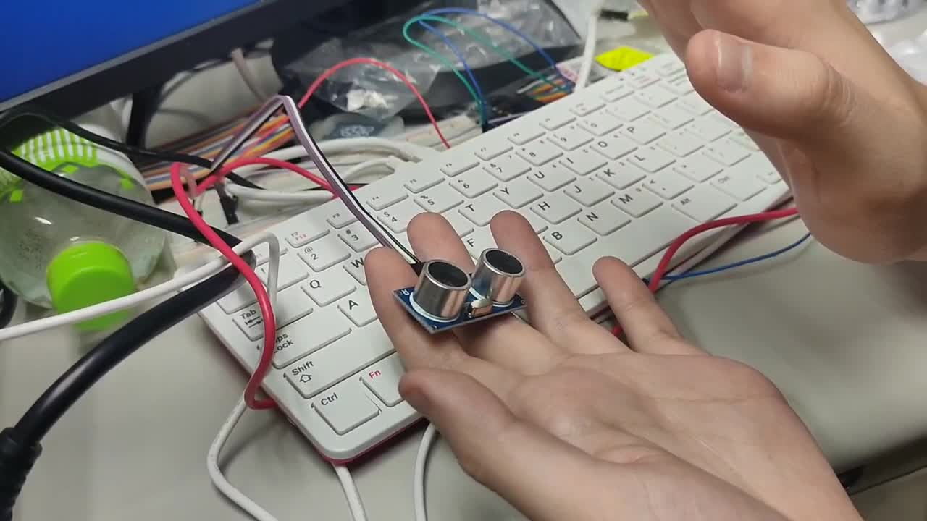
RESULTS

Slide 16

YOLOV5
YOLO Overview
YOLO (You Only Look Once) is a renowned object detection technology in industry and academia.
Cross-Device Compatibility
Latest YOLO versions support diverse devices and operating systems.
Future Potential
Systems become less restricted by hardware or OS, enhancing scalability.

Slide 17
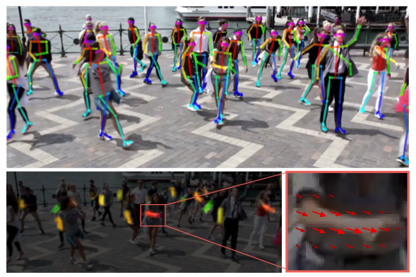
OPENPOSE
OpenPose Overview
Developed by Carnegie Mellon University for real-time multi-person pose estimation.
Key Features
Utilizes PAFs (Part Affinity Fields) to prevent keypoints confusion during overlapping scenarios.
Others
Open-source availability makes it accessible to researchers and developers.

Slide 18

ARTIFICIAL NEURAL NETWORK
Artificial Neural Networks (ANNs) are computational models inspired by the human brain.
Designed to recognize patterns and make decisions based on data input.
Commonly used in machine learning, deep learning, and artificial intelligence."

Slide 19
YOLOV5, OPENPOSE AND ANN COMBINED
YOLOv5 Detection
Successfully stacked multiple-weight models.
Detect passengers, wheelchairs, and other vehicles (e.g., bicycles, scooters, suitcases).
OpenPose Pose Detection
Perform real-time keypoints detection and pose estimation using PAFs for keypoints.
Develop standalone APIs and data processing methods to improve neural network integration efficiency.
ANN Neural Network Object Results and Posture Prediction
Capture specific APIs and data formats to accelerate pose training.
Enhance real-time pose detection with the use of APIs.
Organize information from YOLOv5 and OpenPose to train a decision-making neural network.

Slide 20
YOLOV5, OPENPOSE AND ANN COMBINED
Voice and Text Alert
Display text to inform how many passengers need to board at the station.
Provide voice prompts to notify the driver to stop for passengers.
Optional Feature Modules
Enable communication between the vehicle and station via Wi-Fi and Bluetooth.
Notify the driver of the approaching station.
Turn Signal Controller
Lane Centering Alert
Object and Posture Recognition Based on YOLOv11, Effectively boost speed and support Tiny-level models.

Slide 21
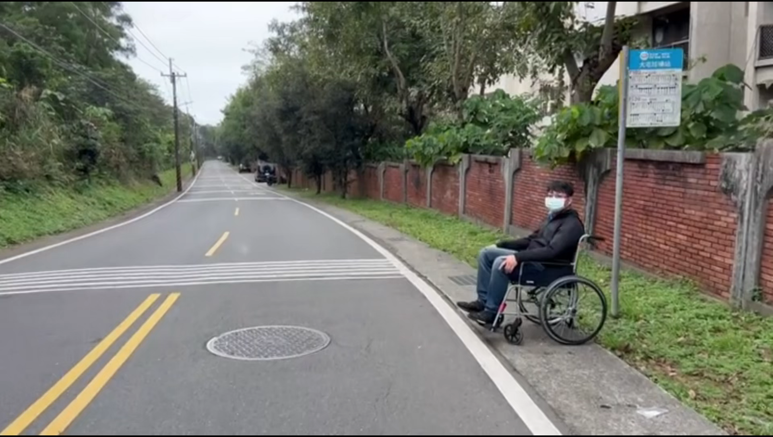
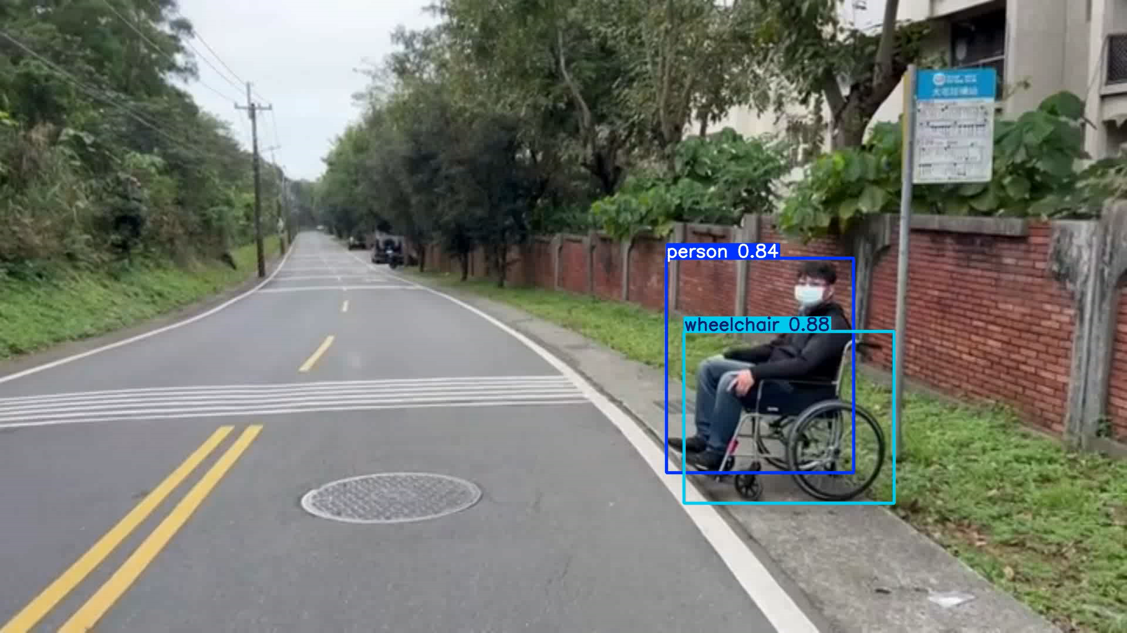
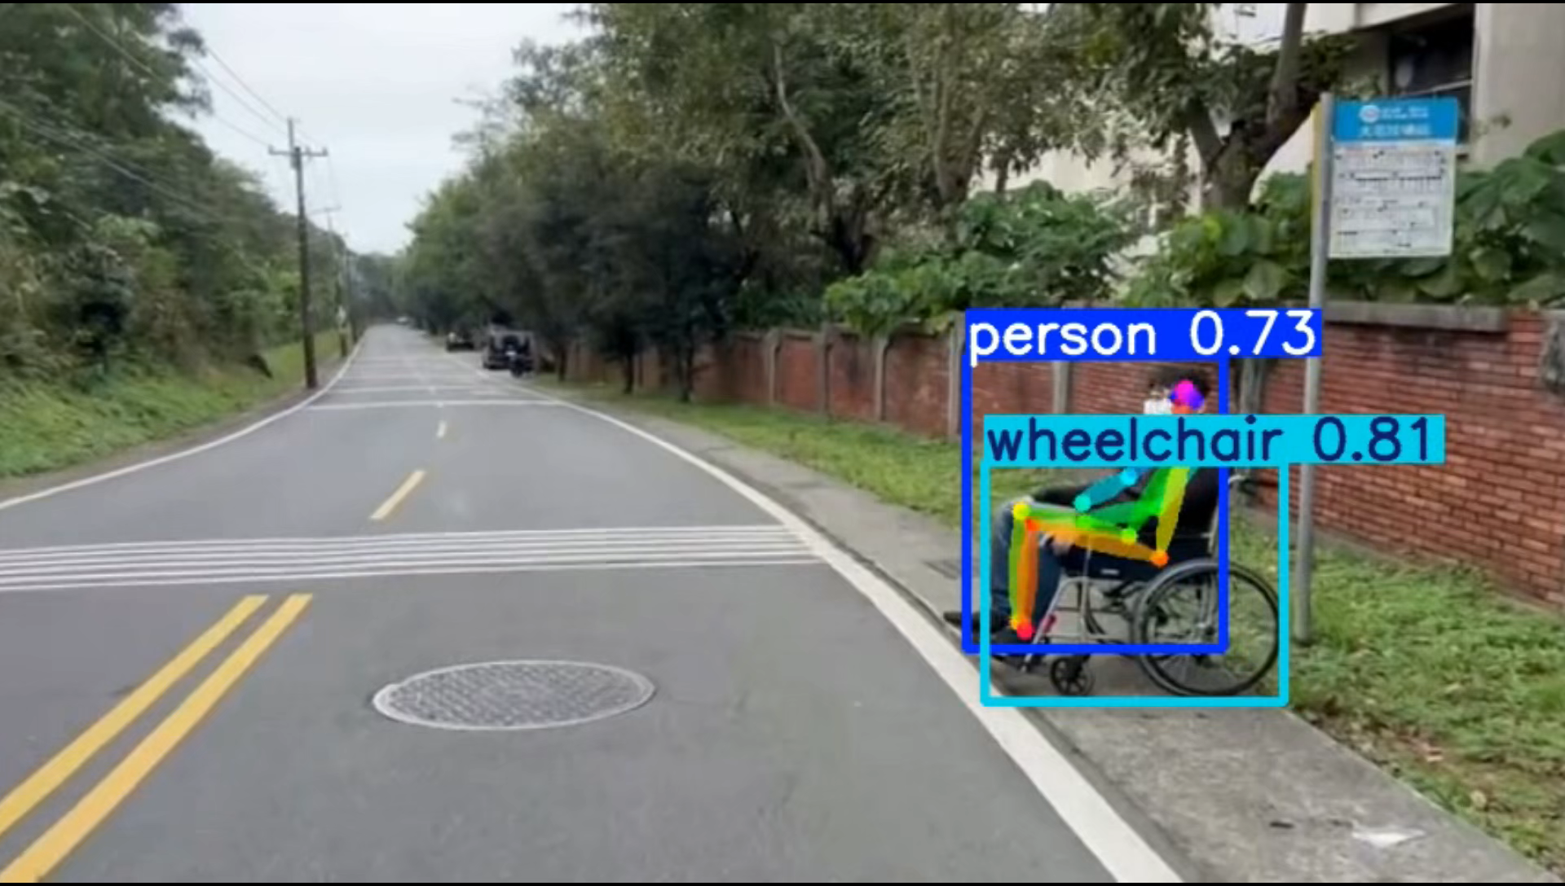
RESULTS OF YOLOV5, OPENPOSE
AND ANN COMBINED
Original
YOLOv5
OpenPose

Slide 22
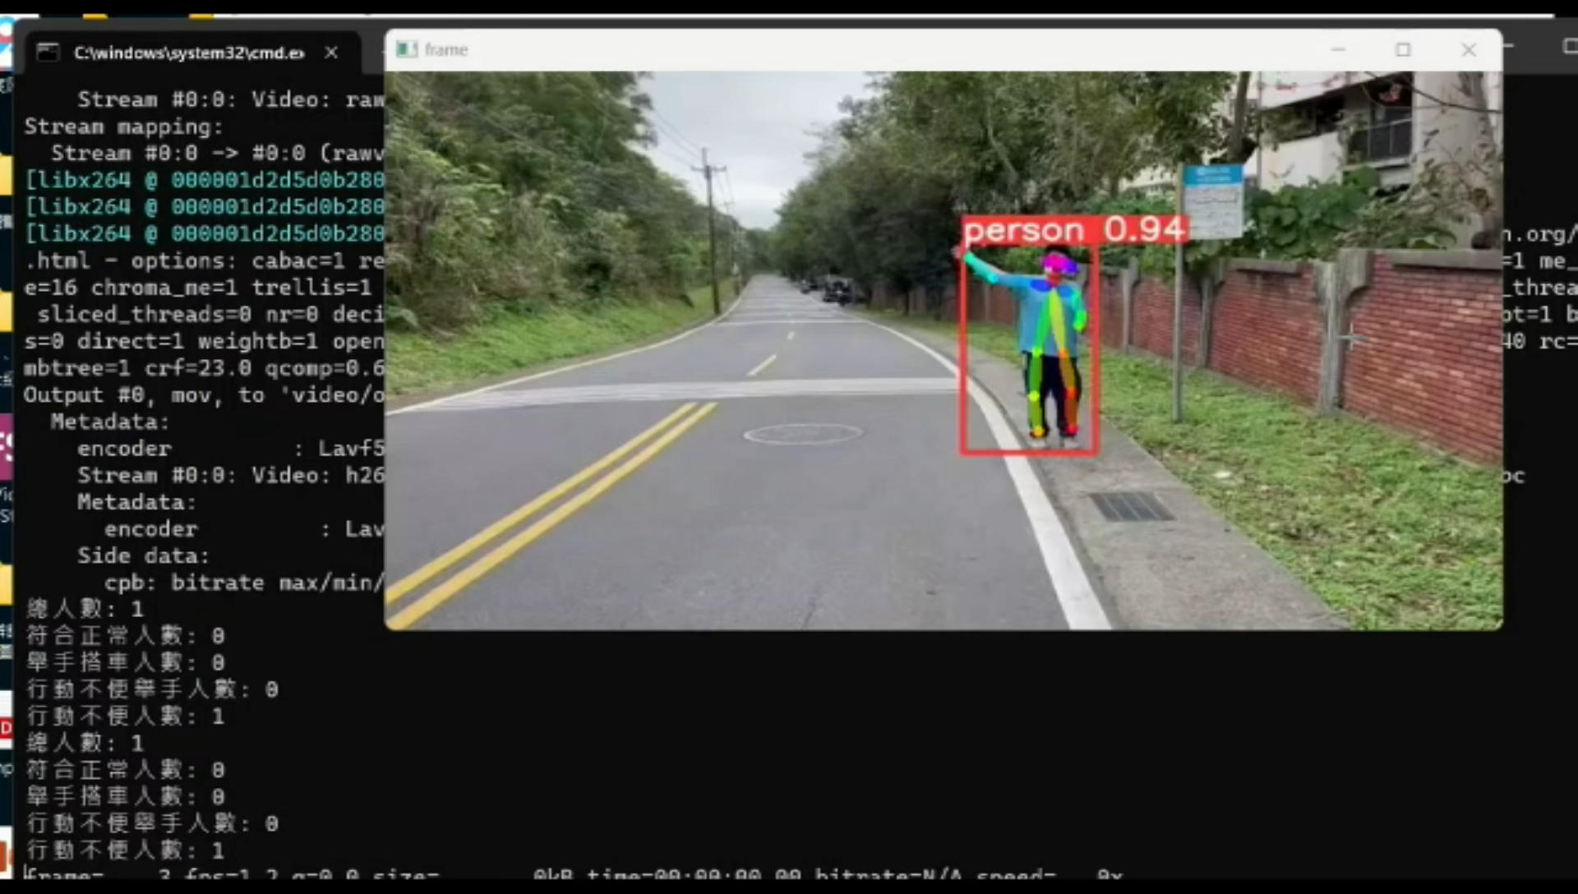
RESULTS OF YOLOV5, OPENPOSE
AND ANN COMBINED
Final

Slide 23
THANK YOU VERY MUCH!

